Slide 1

Northline Group
Financial Sales Dashboard
Data Analyst Internship – Task 4
Prepared by: Ankit Anand Verma
Domain: #24 Data Analyst Interns
Tool: Microsoft Power BI

Slide 2

Northline Group
Project Objective
Designing for Business Insights
Design an interactive sales dashboard using Power BI for business stakeholders to analyze sales performance, profits, products, countries, and segments.
Interactive Dashboard
KPI Monitoring

Slide 3
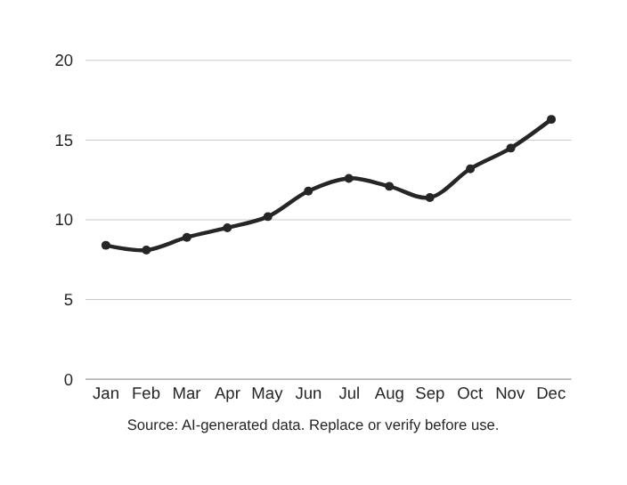
Northline Group
Dashboard Features
118.73M
16.89M
Total Sales
Total Profit
1.13M
14%
Total Units Sold
Profit Margin

Slide 4

Ankit Verma
Interactive
Power BI Dashboard
Financial Sales Analysis
Full-featured interactive dashboard with slicers for Year, Country, Segment, and Product — enabling real-time exploration of sales performance, profit trends, and business KPIs.
Microsoft Power BI
Data Analyst Internship – Task 4
Financial Sales Dashboard

Slide 5
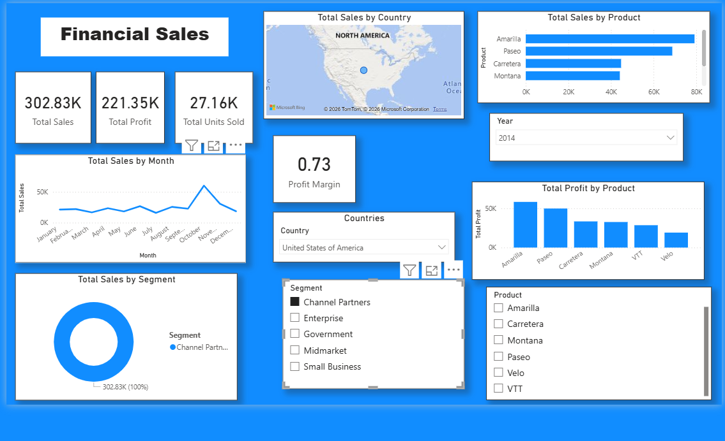
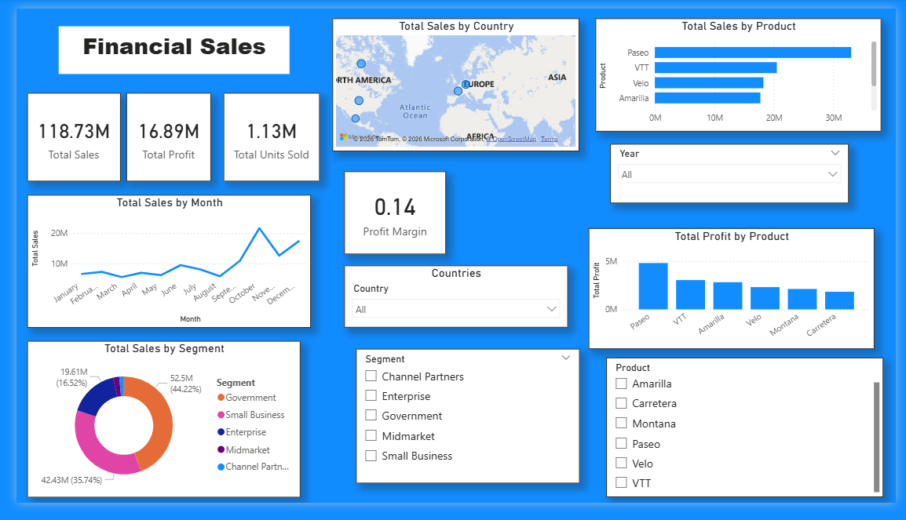
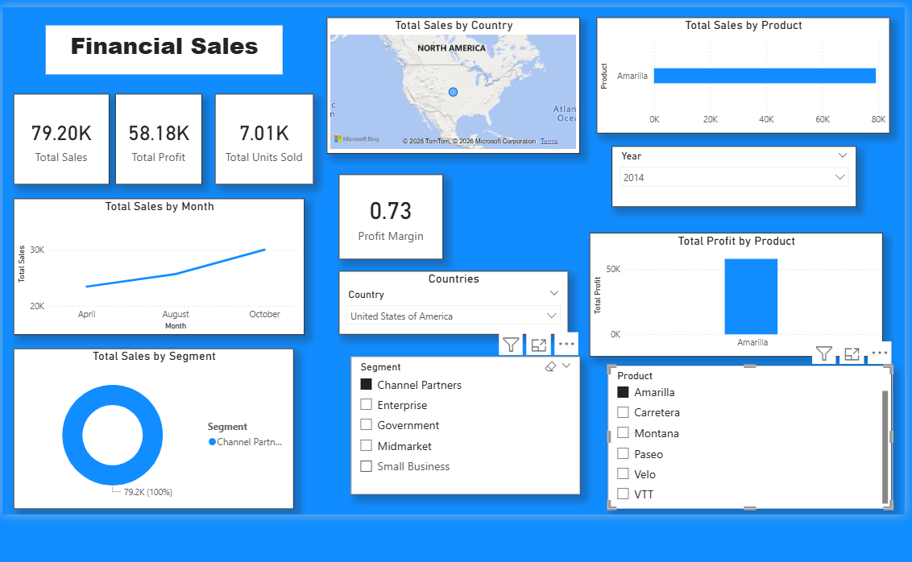
Output Screens

Slide 6
Northline Group
Thank You!
Questions & Answers
• Real-time sales performance monitoring
• Country & product analysis for better decisions
• Interactive filters for efficient data exploration
• Clear visualization of financial KPIs via Power BI

